Slide 1
Trunking & Grade of Service
Cellular radio systems rely on trunking to accommodate a large number of users in a limited radio spectrum.
What is Trunking?
It is a technique that allows a large number of users to share a relatively small number of channels in a cell by providing access to each user, on demand from a pool of available channels.
In a trunked radio system(TRS) each user is allocated a channel on a per call basis, upon termination of the call, the previously occupied channel is immediately returned to the pool of available channels.
Grade Of Service(GOS)
It is a measure of ability of the user to access a trunked system during the busiest hour.

Slide 2
Key Definitions
Set up time: Time required to allocate a radio channel to a requesting user.
Blocked call: A call which cannot be completed at the time of request, due to congestion(lost call).
Holding Time: Average duration of a call. Denoted by H (in Seconds)
Request Rate: The average number of calls request per unit time (λ).
Traffic Intensity: Measure of channel time utilization or the average channel occupancy measured in Erlangs. Denoted by A.
Load: Traffic intensity across the entire Trunked Radio System.

Slide 3
Trunking and Grade Of Service
Traffic Intensity offered by each user (Au): Average call arrival rate multiplied by the holding time
Au= λH (Erlangs)
Total Offered traffic intensity for a system of U users(A): Traffic intensity offered by each user multiplied by the total number of user expressed in Erlangs
A= U* Au (Erlangs)
Traffic Intensity per channel, in a C channel trunked system is given by
Ac= U*Au/C (Erlangs)

Slide 4
Types of Trunked Systems
Blocked call cleared System
Blocked call delayed System

Slide 5
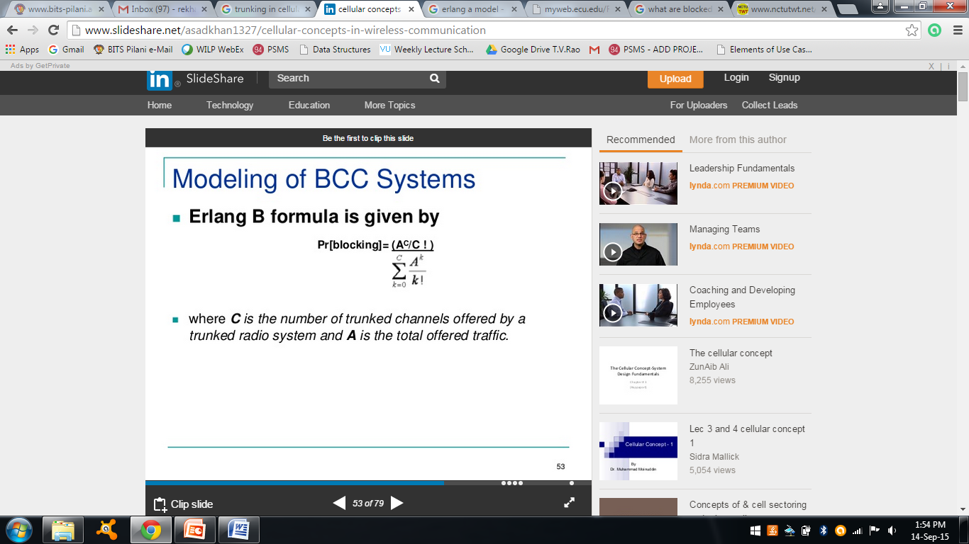
Blocked Call Cleared System
When a user request service, there is a minimal call set up time and the user is given immediate access to a channel if one is available.
If the channels are already in use and no new channels are available, call is blocked with out access to the system.
The user does not receive Service, but is free to try again.
Erlang B Formula determines the probability that a call is blocked is given by
C is the number of trunked Channels .
A is the total traffic offered.

Slide 6
Blocked Call Delayed System
Queues are used to hold call request that are initially blocked.
When a user attempts a call and a channel is not immediately available, the call request may be delayed until a channel becomes available.
If call cannot be assigned a channel, it is placed in a queue.
Each call is then serviced in the order of its arrival.

Slide 7
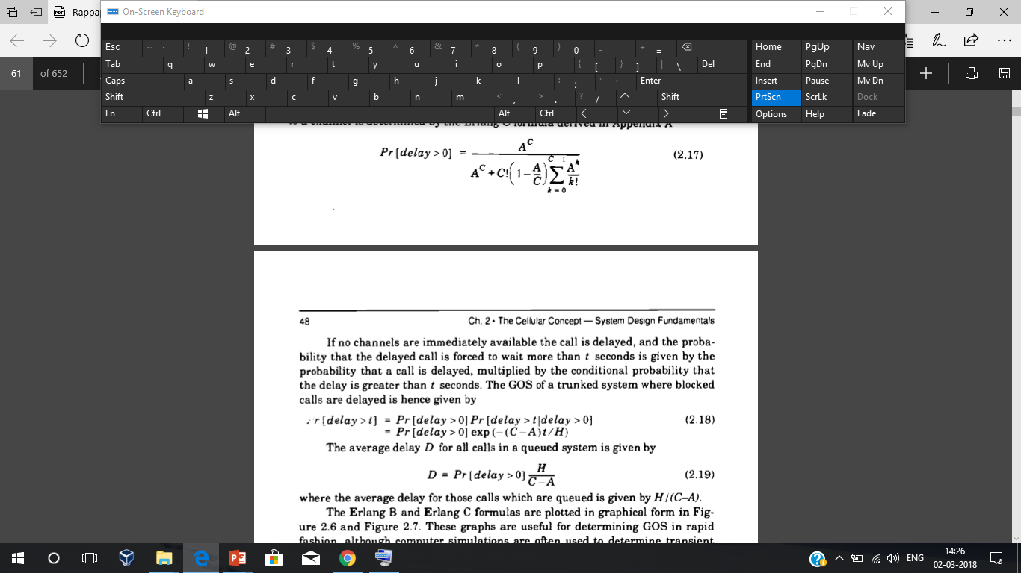
Blocked Call Delayed System
The probability that the call not having the immediate access to a channel is determined by Erlang C formula
The probability that the call is forced to wait for more than t seconds is given by
C is the number of trunked Channels .
A is the total traffic offered, H – Holding time.

Slide 8

Blocked Call Delayed System
The average delay for all the calls in a queued system is

Slide 9
Problems
394 cells in trunked radio system with 19 channels each
Each user averages 2 calls per hour
Average call duration 3 minutes
Number of users supported at 2% blocking?
Total number of users supported by system
Solution:
From Erlang B chart, Total traffic carried,A= 12.33
Traffic intensity offered by each user : Au= λH = 2*(3/60) = 0.1 erlang
U= A/Au= 12.33/0.1= 123.3
There are 394 cells , the total number of subscribers that can be supported is 123.3*394 = 48580

Slide 10
Summary
Trunking is used to accommodate a large number of users in a limited radio spectrum.
In a blocked call clear system, the probability that a call is blocked depend on the number of trunked channels and the total traffic offered.
In a block called delay system queues are used to hold call request that are initially blocked.

